Slide 1
Name : A.rekha Register no : 312214937 / asunm1483312214937 Department : b.com (general) College : annai VEILANKANNi’s college for women

Slide 2
PROJECT TITLE
Employee performance analysis using excel

Slide 3
AGENDA
Problem Statement
Project Overview
End users
Our solution and proposition
Dataset description
Modelling approach
Results and discussion
Conclusion

Slide 4
PROBLEM STATEMENT
Accurately evaluate employee performance
Identify strengths,weakness,opportunities and threats (SWOT analysis)
Develop targeted intervention and training programs
Inform talent management decisions (Promotion,Successions)

Slide 5
PROJECT OVERVIEW
Analysis employee performance data to identify key drivers of performance and area for improvement
Develop data - driven insights to inform talent management decisions,training programs,leadership development initiatives
Focus on identifying key precditors of performance ,area of improvement and opportunities for growth and development

Slide 6
END USERS
Line manager
HR business partners
Senior leadership
Employee development teams
Compensation and benefits teams
Talent acquisition teams
Employees
Orangizational development teams

Slide 7
OUR SOLUTION AND ITS VALUE PROPOSITION
Solution : Empower AI employee performance insights
Value proportion
Identify top performers
Pinpoint skill gaps
Enhance employee engagement
Inform data – driven decision
Boost productivity

Slide 8
DATA DESCRIPTION
Description : This data set contains information on employee performance , demographics and development activities
Fields :
Employee ID
Name
Job role
Department
Performance rating
Performance level

Slide 9
THE “WOW” IN OUR SOLUTION
AI driven predictive analytics for accurate forecasting insights
Automated performance scoring for unbiased evaluations
Personalized development plans for targeted growth and improvement
Real – time feedback and coaching for continuous development
Intuitive and interactive dashboard for visualization and tracking

Slide 10
DELLING APPROACH
Regression analysis
Decision trees
Clustering analysis
Predictive modelling
Propsentive scoring
Survival analysis
Network analysis
Machine learning algorithms
Stimulation modelling
Bayesian networks

Slide 11
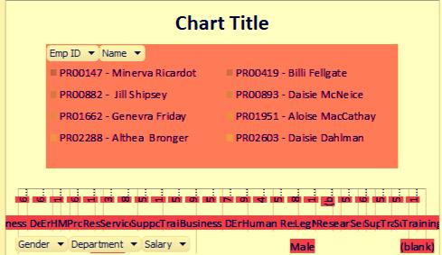
RESULTS AND DISCUSSION

Slide 12
CONCLUSION
Employee performance analysis is a critical component of talent management, enabling organization to make data driven decision , driven business outputs and enhance employee experience by leveraging advance analytics modelling techniques.

